Slide 1
Introduction to Logic Circuits
Information in computers is represented as electronic signals that have two values: 0 and 1.
Digital technology deals with the binary logic circuits that have two logic values.
The simplest binary element is a switch that has two states.
If a given switch is controlled by an input variable x, then the switch is open if x = 0 and closed if x = 1,
S
x
=
0
x
=
1
x
Two states of a switch
Symbol for a switch

Slide 2
Simple application of a switch
A switch turns a small lightbulb on or off.
A battery provides the power source. The lightbulb glows when a sufficient amount of current passes through it.
The current flows when the switch is closed, that is, when x = 1. Let the light glowing be denoted by L which depends on x.
So L(x) = x.
S
Power
supply
x
Light

Slide 3
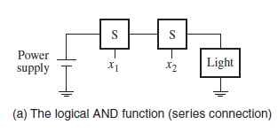
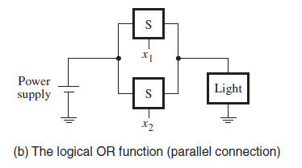
AND and OR functions
Consider now the use of two switches to control the state of the light. Let x₁ and x₂ be the control inputs for these switches. The switches can be connected either in series or in parallel.
Using a series connection, the light is turned on only if both switches are closed. If either switch is open, the light will be off.
In the parallel connection, the light will be on if either the x₁ or x₂ switch is closed and if both switches are closed. The light will be off only if both switches are open.
L(x₁,x₂) = x₁ . x₂
L(x₁,x₂) = x₁ + x₂

Slide 4
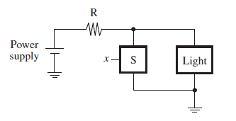
Inverter(NOT)
If a switch is connected in parallel with the light, a closed switch will short-circuit the light and prevent the current from flowing through it.
An extra resistor is included in this circuit to ensure that the closed switch does not short-circuit the power supply. The light will be turned on when the switch is opened.
The value of the output is the inverse of the value of the input. Hence the term complement or NOT is used.

Slide 5
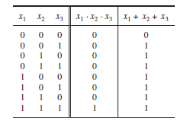
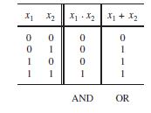


Truth Table
The operations AND, OR and NOT can be defined in the form of a table, called a truth table.
Truth table of
Truth table of NOT
Truth table of three input AND and OR

Slide 6



Logic Gates and Networks
The three basic logic operations AND,OR and NOT can be used to implement logic functions of any complexity.
Each logic operation can be implemented electronically
with transistors, resulting in a circuit element called a logic gate.
A logic gate has one or more inputs and one output that is a function of its inputs.
It is convenient to describe a logic circuit by drawing a circuit diagram, or schematic, consisting of graphical symbols. Symbols for the AND, OR, and NOT gates:
AND
OR
NOT

Slide 7
Analysis of a Logic Network
A larger circuit is implemented by a network of gates which is called a logic network or simply a logic circuit.
A designer of digital systems has two basic issues:
For an existing logic network, it must be possible to determine the function performed by the network. This task is referred to as the analysis process.(simple)
The reverse task of designing a new network that implements a desired functional behavior is referred to as the synthesis process.(not as simple as analysis)
Consider a simple network consisting of 3 gates.
To analyze its function, first make x₁ = x₂ = 0. This forces the output of the NOT gate to be equal to 1 and the output of the AND gate to be 0. As one of the inputs to the OR gate is 1, the output of it will be 1. Hence, f = 1 if x₁ = x₂ = 0.
Now apply all possible combinations of inputs to the circuit.

Slide 8
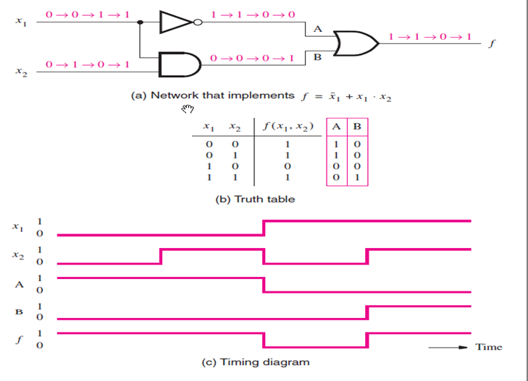
logic network 1 - an example

Slide 9
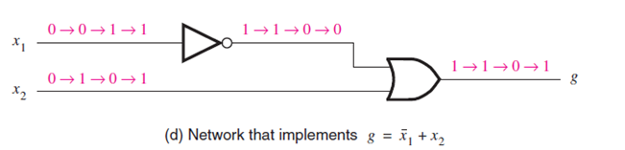
Functionally Equivalent Networks
The output g in network 2 changes in exactly the same way as the output f in network 1.
Hence g(x₁, x₂) = f (x₁, x₂), which means that the two networks are functionally equivalent. As both networks realize the same function, it makes sense to use the simpler one, which is less costly to implement.
Hence =
A logic function can be implemented with a variety of different networks, probably having different costs.
logic network 2 - an example

Slide 10
Boolean Algebra - Axioms
George Boole published a scheme for the algebraic description of processes involved in logical thought and reasoning which became known as Boolean algebra.
1a. 0· 0 = 0 1b. 1+ 1 = 1
2a. 1· 1 = 1 2b. 0+ 0 = 0
3a. 0· 1 = 1 · 0 = 0 3b. 1+ 0 = 0 + 1 = 1
4a. If x = 0, then = 1 4b. If x = 1, then = 0
5a. x · 0 = 0 5b. x + 1 = 1
6a. x · 1 = x 6b. x + 0 = x
7a. x · x = x 7b. x + x = x
8a. x · x’ = 0 8b. x + x’ = 1
9. = x

Slide 11
Duality
The axioms have been listed in pairs.
This is done to reflect the important principle of duality.
Given a logic expression, its dual is obtained by replacing all + operators with · operators, and vice versa, and by replacing all 0s with 1s, and vice versa.
The dual of any true statement in Boolean algebra is also a true statement.

Slide 12
Two- and Three-Variable Properties
x · y = y · x Commutative x + y = y + x
x · ( y · z) = (x · y) · z Associative
x + ( y + z) = (x + y) + z
x · ( y + z) = x · y + x · z Distributive
x + y · z = (x + y) · (x + z)
x + (x · y) = x Absorption x · (x + y) = x
x · y + x · y = x Combining (x + y) · (x + y) = x
(x · y)’ = x’ + y’ DeMorgan’s theorem (x + y)’ = x’ · y’
x + (x’ · y) = x + y x · (x’ + y) = x · y
x · y + y · z + x’·z = x · y + x’ · z Consensus
(x + y) · (y + z) · (x’ + z) = (x + y) · (x’ + z)

Slide 13
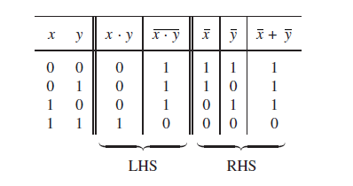
DeMorgan’s theorem

Slide 14
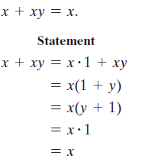
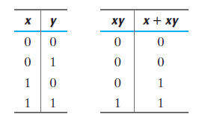
Absorption Theorem
Operator Precedence
The operator precedence for evaluating Boolean expressions is (1) parentheses, (2) NOT, (3) AND, and (4) OR.

Slide 15
Simplify to a minimum number of literals.
x(x’ + y)
= xx’ + xy
= 0 + xy
= xy.
2. x + (x’y)
= (x + x’)(x + y)
= 1(x + y)
= x + y.
xy + x’z + yz
= xy + x’z + yz(x + x’)
= xy + x’z + xyz + x’yz
= xy(1 + z) + x’z(1 + y) = xy + x’z.

Slide 16
Complement
Find the complement of the function
Using Demorgan’s theorem
F₁ = x’yz’ + x’y’z
F₁‘= (x’yz’ + x’y’z)’
= (x’yz’)’(x’y’z)’ = (x + y’ + z)(x + y + z’)
Complement can also be obtained by taking the dual of the function and complementing each literal.
F₁ = x’yz’ + x’y’z.
The dual of F₁ is (x’ + y + z’)(x’ + y’ + z).
Complement each literal: (x + y’ + z)(x + y + z’) = F₁‘

Slide 17
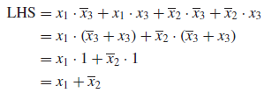
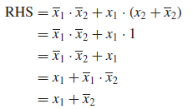
Prove the validity of the logic equation

Slide 18

Sum of Products(SOP) and Product of Sum (POS)
Boolean algebra is based on the AND and OR operations, for which the symbols · and + are used.. Considerable similarity exists between the Boolean operations and the arithmetic operations.
Because of the similarity with the arithmetic addition and multiplication operations, the OR and AND operations are often called the logical sum and product operations.
is an SOP
is a POS

Slide 19
Summary
Binary logic – logic 0 and logic 1
AND , OR and NOT functions
Truth Table
Analysis of a Logic Network
Synthesis of a Logic Network
Functionally Equivalent Networks
Boolean Algebra – Axioms
Duality
Complement
Sum of Products(SOP) and Product of Sum (POS)

